Slide 1
Neural Networks in Ecology
A gentle introduction

Slide 2
What’s to expect?
Let me introduce myself
What are neural networks anyway
Very basic example in R
Less basic example in Python
And beyond...

Slide 3
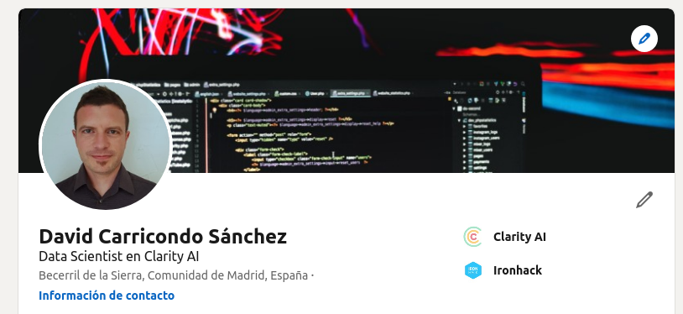
Who is this guy anyway?
LinkedIn:
https://www.linkedin.com/in/david-carricondo-sanchez/
GitHub
https://github.com/DavidCarricondo
Email
david.carricondo.sanchez@gmail.com
Bc. Biology
Master Ecosystem functioning
Technician/Research
PhD Applied Ecology
Postdoc/Lecturer
Academic dropout
Data Scientist

Slide 4
What is a neural network anyway?

Slide 5
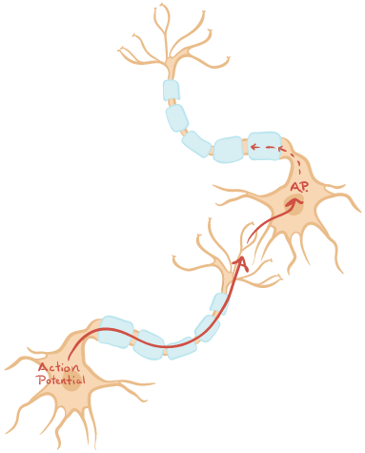
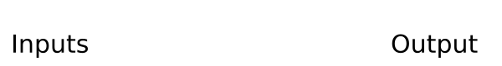
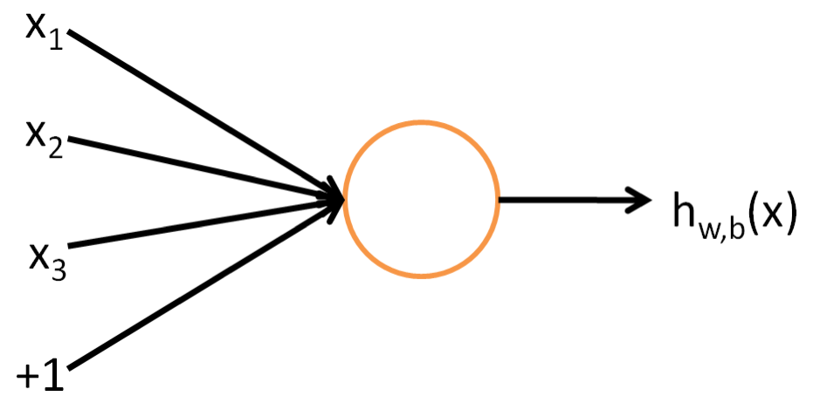
Neural networks
Branch of AI
Try to get inspiration from the brain learning

Slide 6
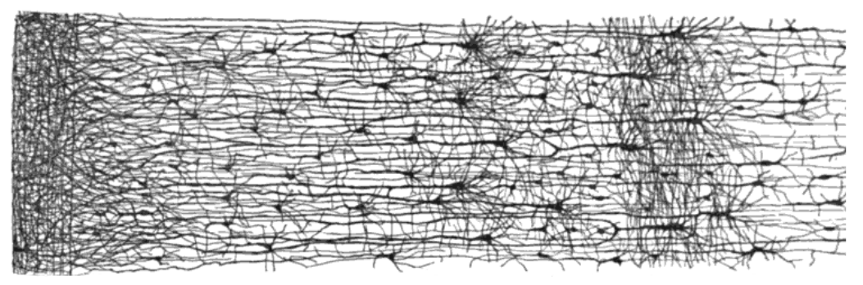
Neural networks
Composed of different layers
Input layer
Hidden layers
Output layer
Each layer containing a number of ‘neurons’

Slide 7
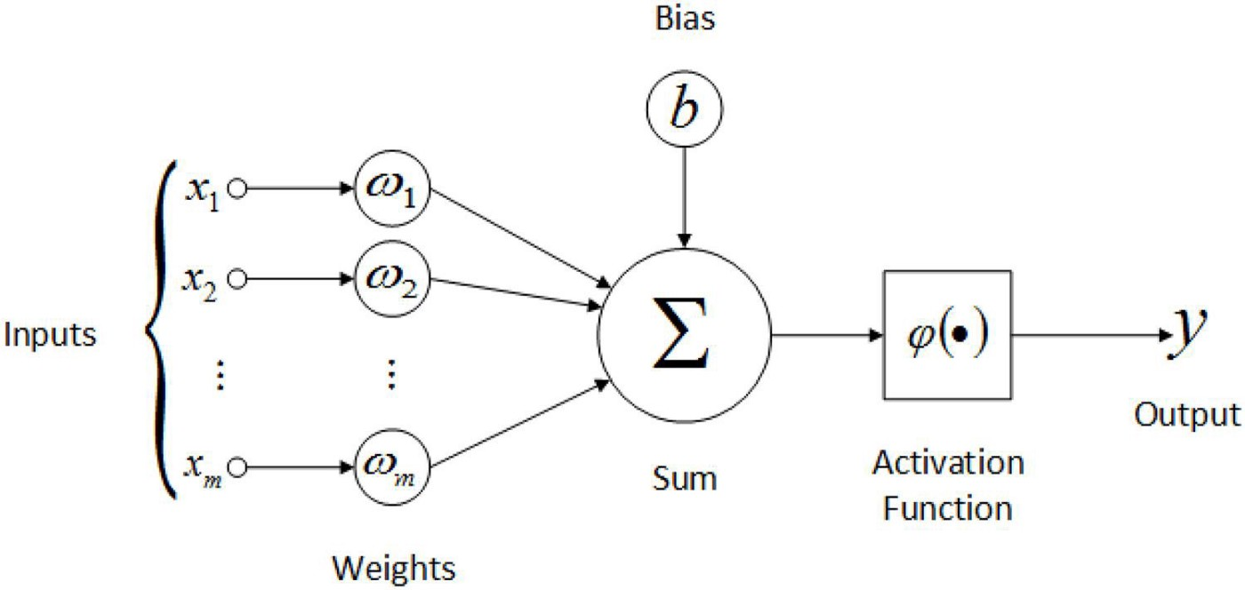
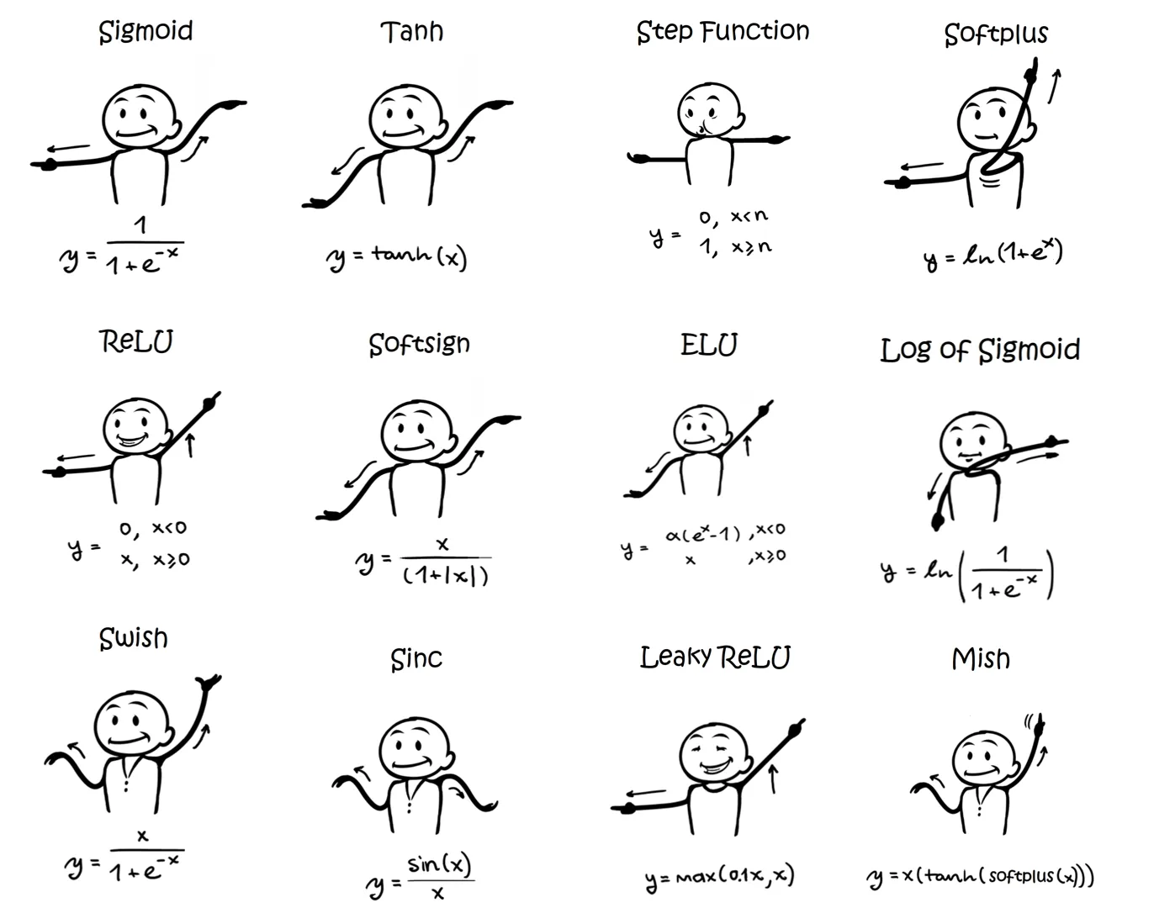
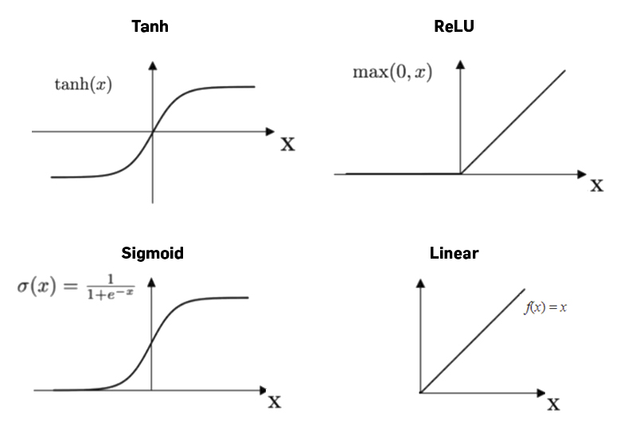
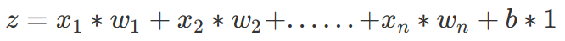
Forward pass
What happens within each neuron?
Activation functions

Slide 8
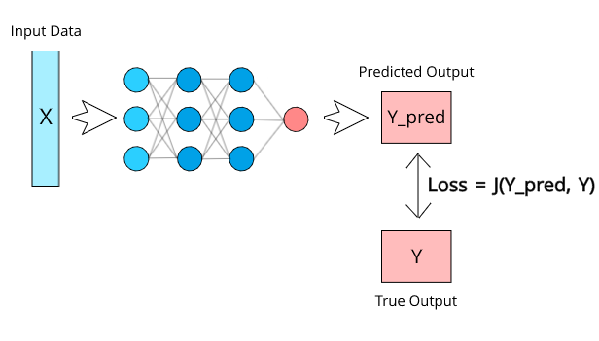

Forward pass
Loss function compares the predicted value with the true value
But the value will be computed from random parameters?

Slide 9
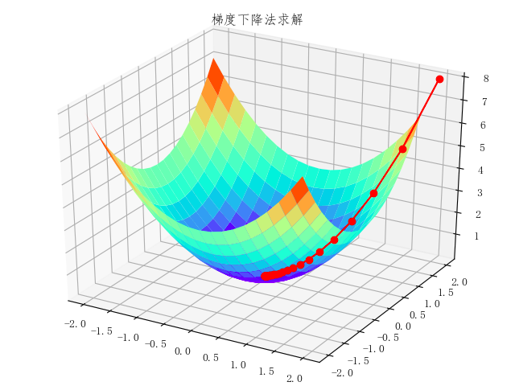
Backpropagation
Here is where the actual learning happens
Gradient descent algorithm will find the optimun…
By slightly updating the model weights in each epoch

Slide 10
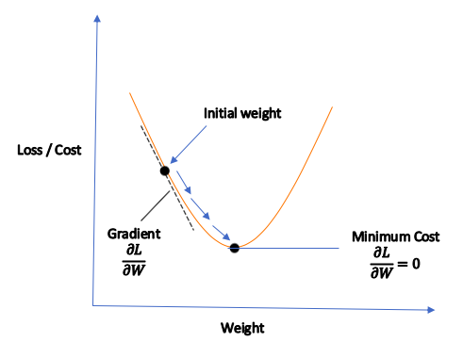
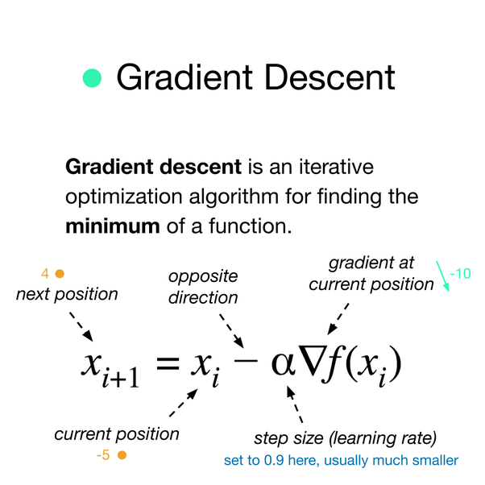
Backwards pass
By calculating derivatives, it computes how much each connection contributed to the error (Chain rule).
Then calculates how much of the error contribution comes from each connection in the previous layer.
Finally, all the weights are tweaked using the error gradient computed.

Slide 11
Backwards pass
FOR EACH EPOCH:

Slide 12
Very basic R example
Regression in R. House price prediction: https://github.com/DavidCarricondo/nn_ecology_workshop

Slide 13
Less basic Python example
Why python?

Slide 14
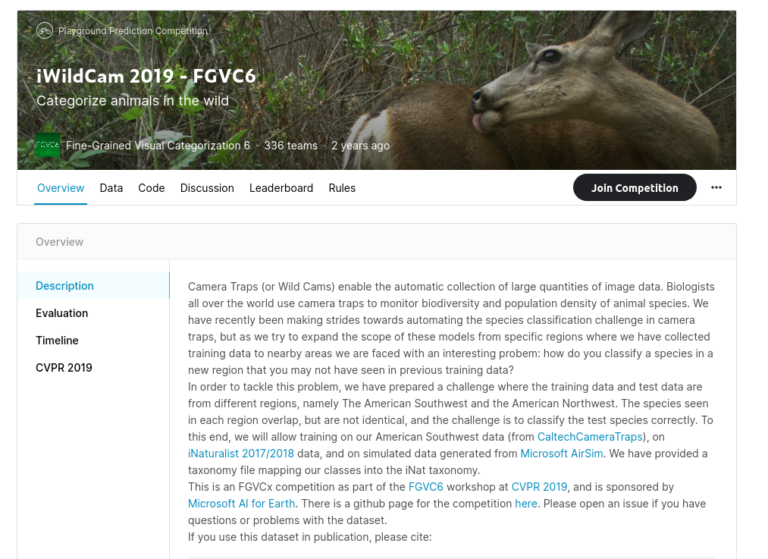
THE DATA
https://www.kaggle.com/c/iwildcam-2019-fgvc6
PROCESS
1.Images resizing
2.Fitting a CNN
3.Transfer learning of pre-trained model

Slide 15
Convolutional
Neural
Networks

Slide 16
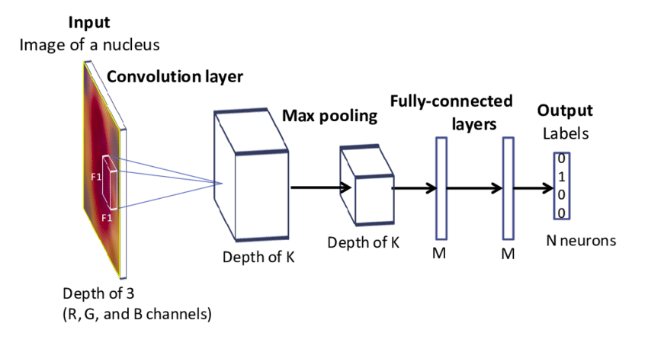
Convolutional network

Slide 17
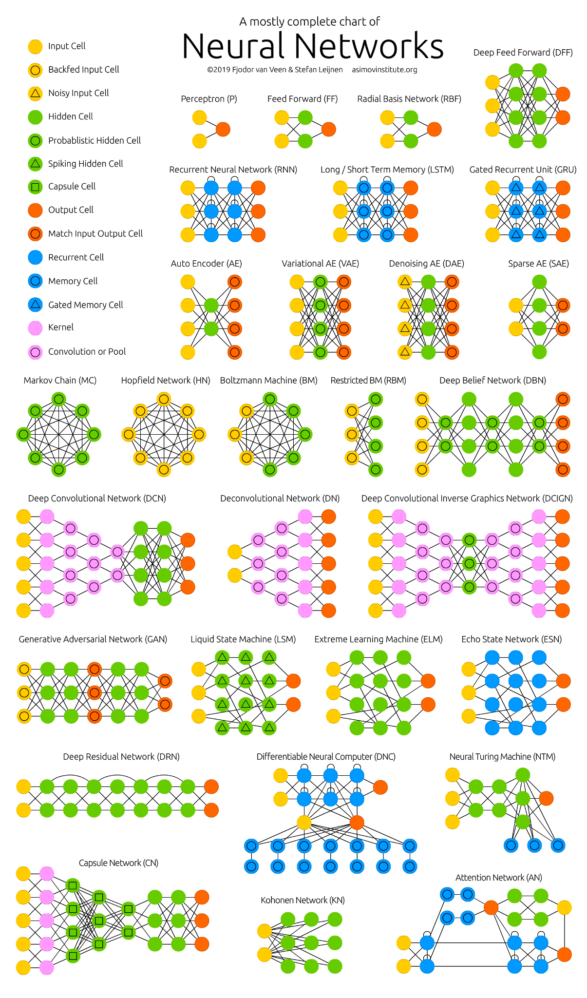
...and beyond

Slide 18
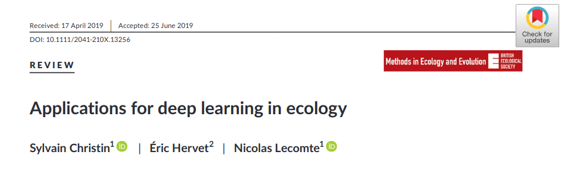
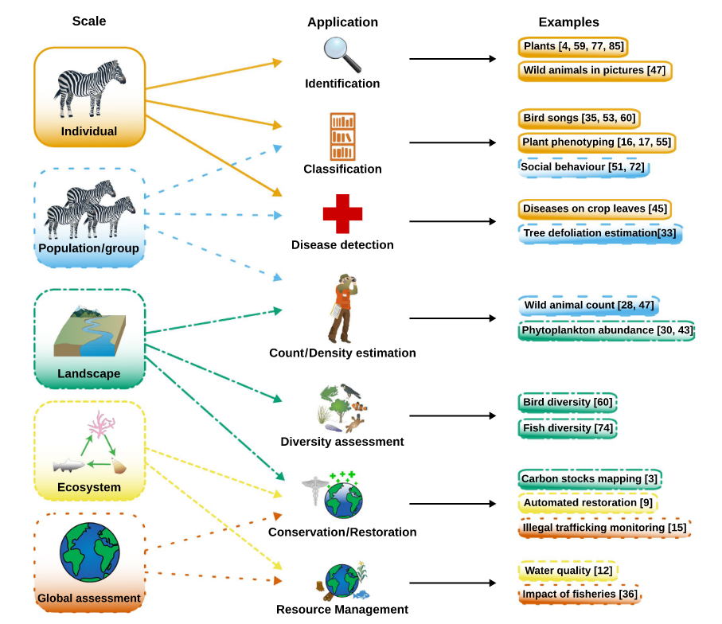
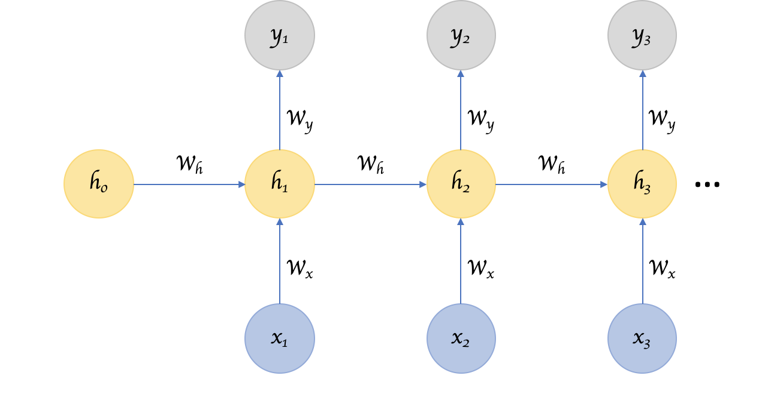

https://besjournals.onlinelibrary.wiley.com/doi/10.1111/2041-210X.13256

